Slide 1
Chapter 2: Association Rules & Sequential Patterns

Slide 2
Road map
Basic concepts of Association Rules
Apriori algorithm
Different data formats for mining
Mining with multiple minimum supports
Mining class association rules
Sequential pattern mining
Summary

Slide 3
Association rule mining
Proposed by Agrawal et al in 1993.
It is an important data mining model studied extensively by the database and data mining community.
Assume all data are categorical.
No good algorithm for numeric data.
Initially used for Market Basket Analysis to find how items purchased by customers are related.
Bread → Milk [sup = 5%, conf = 100%]

Slide 4
The model: data
I = {i₁, i₂, …, i_{m}}: a set of items.
Transaction t :
t a set of items, and t ⊆ I.
Transaction Database T: a set of transactions T = {t₁, t₂, …, t_{n}}.

Slide 5
Transaction data: supermarket data
Market basket transactions:
t1: {bread, cheese, milk}
t2: {apple, eggs, salt, yogurt}
… …
tn: {biscuit, eggs, milk}
Concepts:
An item: an item/article in a basket
I: the set of all items sold in the store
A transaction: items purchased in a basket; it may have TID (transaction ID)
A transactional dataset: A set of transactions

Slide 6
Transaction data: a set of documents
A text document data set. Each document is treated as a “bag” of keywords
doc1: Student, Teach, School
doc2: Student, School
doc3: Teach, School, City, Game
doc4: Baseball, Basketball
doc5: Basketball, Player, Spectator
doc6: Baseball, Coach, Game, Team
doc7: Basketball, Team, City, Game

Slide 7
The model: rules
A transaction t contains X, a set of items (itemset) in I, if X ⊆ t.
An association rule is an implication of the form:
X → Y, where X, Y ⊂ I, and X ∩Y = ∅
An itemset is a set of items.
E.g., X = {milk, bread, cereal} is an itemset.
A k-itemset is an itemset with k items.
E.g., {milk, bread, cereal} is a 3-itemset

Slide 8
Rule strength measures
Support: The rule holds with support sup in T (the transaction data set) if sup% of transactions contain X ∪ Y.
sup = Pr(X ∪ Y).
Confidence: The rule holds in T with confidence conf if conf% of tranactions that contain X also contain Y.
conf = Pr(Y | X)
An association rule is a pattern that states when X occurs, Y occurs with certain probability.

Slide 9
Support and Confidence
Support count: The support count of an itemset X, denoted by X.count, in a data set T is the number of transactions in T that contain X. Assume T has n transactions.
Then,

Slide 10
Goal and key features
Goal: Find all rules that satisfy the user-specified minimum support (minsup) and minimum confidence (minconf).
Key Features
Completeness: find all rules.
No target item(s) on the right-hand-side
Mining with data on hard disk (not in memory)

Slide 11
An example
t1: Beef, Chicken, Milk
t2: Beef, Cheese
t3: Cheese, Boots
t4: Beef, Chicken, Cheese
t5: Beef, Chicken, Clothes, Cheese, Milk
t6: Chicken, Clothes, Milk
t7: Chicken, Milk, Clothes
Transaction data
Assume:
minsup = 30%
minconf = 80%
An example frequent itemset:
{Chicken, Clothes, Milk} [sup = 3/7]
Association rules from the itemset:
Clothes → Milk, Chicken [sup = 3/7, conf = 3/3]
… …
Clothes, Chicken → Milk, [sup = 3/7, conf = 3/3]

Slide 12
Transaction data representation
A simplistic view of shopping baskets,
Some important information not considered. E.g,
the quantity of each item purchased and
the price paid.

Slide 13
Many mining algorithms
There are a large number of them!!
They use different strategies and data structures.
Their resulting sets of rules are all the same.
Given a transaction data set T, and a minimum support and a minimum confident, the set of association rules existing in T is uniquely determined.
Any algorithm should find the same set of rules although their computational efficiencies and memory requirements may be different.
We study only one: the Apriori Algorithm

Slide 14
Road map
Basic concepts of Association Rules
Apriori algorithm
Different data formats for mining
Mining with multiple minimum supports
Mining class association rules
Sequential pattern mining
Summary

Slide 15
The Apriori algorithm
The best known algorithm
Two steps:
Find all itemsets that have minimum support (frequent itemsets, also called large itemsets).
Use frequent itemsets to generate rules.
E.g., a frequent itemset
{Chicken, Clothes, Milk} [sup = 3/7]
and one rule from the frequent itemset
Clothes → Milk, Chicken [sup = 3/7, conf = 3/3]

Slide 16
Step 1: Mining all frequent itemsets
A frequent itemset is an itemset whose support is ≥ minsup.
Key idea: The apriori property (downward closure property): any subsets of a frequent itemset are also frequent itemsets
ABC ABD ACD BCD
AB AC AD BC BD CD
A B C D

Slide 17
The Algorithm
Iterative algo. (also called level-wise search): Find all 1-item frequent itemsets; then all 2-item frequent itemsets, and so on.
In each iteration k, only consider itemsets that contain some k-1 frequent itemset.
Find frequent itemsets of size 1: F₁
From k = 2
C_{k} = candidates of size k: those itemsets of size k that could be frequent, given F_{k-1}
F_{k} = those itemsets that are actually frequent, F_{k} ⊆ C_{k} (need to scan the database once).

Slide 18
Example – Finding frequent itemsets
Dataset T
TID | Items
T100 | 1, 3, 4
T200 | 2, 3, 5
T300 | 1, 2, 3, 5
T400 | 2, 5
minsup=0.5
itemset:count
1. scan T ➔ C₁: {1}:2, {2}:3, {3}:3, {4}:1, {5}:3
➔ F₁: {1}:2, {2}:3, {3}:3, {5}:3
➔ C₂: {1,2}, {1,3}, {1,5}, {2,3}, {2,5}, {3,5}
2. scan T ➔ C₂: {1,2}:1, {1,3}:2, {1,5}:1, {2,3}:2, {2,5}:3, {3,5}:2
➔ F₂: {1,3}:2, {2,3}:2, {2,5}:3, {3,5}:2
➔ C₃: {2, 3,5}
3. scan T ➔ C₃: {2, 3, 5}:2 ➔ F_{3:} {2, 3, 5}

Slide 19
Details: ordering of items
The items in I are sorted in lexicographic order (which is a total order).
The order is used throughout the algorithm in each itemset.
{w[1], w[2], …, w[k]} represents a k-itemset w consisting of items w[1], w[2], …, w[k], where w[1] < w[2] < … < w[k] according to the total order.

Slide 20
Details: the algorithm
Algorithm Apriori(T)
C₁ ← init-pass(T);
F₁ ← {f | f ∈ C₁, f.count/n ≥ minsup}; // n: no. of transactions in T
for (k = 2; F_{k-1} ≠ ∅; k++) do
C_{k} ← candidate-gen(F_{k-1});
for each transaction t ∈ T do
for each candidate c ∈ C_{k} do
if c is contained in t then
c.count++;
end
end
F_{k} ← {c ∈ C_{k} | c.count/n ≥ minsup}
end
return F ← _{k} F_{k};

Slide 21
Apriori candidate generation
The candidate-gen function takes F_{k-1} and returns a superset (called the candidates) of the set of all frequent k-itemsets. It has two steps
join step: Generate all possible candidate itemsets C_{k} of length k
prune step: Remove those candidates in C_{k} that cannot be frequent.

Slide 22
Candidate-gen function
Function candidate-gen(F_{k-1})
C_{k} ← ∅;
forall f₁, f₂ ∈ F_{k-1}
with f₁ = {i₁, … , i_{k-2}, i_{k-1}}
and f₂ = {i₁, … , i_{k-2}, i’_{k-1}}
and i_{k-1} < i’_{k-1} do
c ← {i₁, …, i_{k-1}, i’_{k-1}}; // join f₁ and f₂
C_{k} ← C_{k} ∪ {c};
for each (k-1)-subset s of c do
if (s ∉ F_{k-1}) then
delete c from C_{k}; // prune
end
end
return C_{k};

Slide 23
An example
F₃ = {{1, 2, 3}, {1, 2, 4}, {1, 3, 4},
{1, 3, 5}, {2, 3, 4}}
After join
C₄ = {{1, 2, 3, 4}, {1, 3, 4, 5}}
After pruning:
C₄ = {{1, 2, 3, 4}}
because {1, 4, 5} is not in F₃ ({1, 3, 4, 5} is removed)

Slide 24
Step 2: Generating rules from frequent itemsets
Frequent itemsets ≠ association rules
One more step is needed to generate association rules
For each frequent itemset X,
For each proper nonempty subset A of X,
Let B = X - A
A → B is an association rule if
Confidence(A → B) ≥ minconf,
support(A → B) = support(A∪B) = support(X)
confidence(A → B) = support(A ∪ B) / support(A)

Slide 25
Generating rules: an example
Suppose {2,3,4} is frequent, with sup=50%
Proper nonempty subsets: {2,3}, {2,4}, {3,4}, {2}, {3}, {4}, with sup=50%, 50%, 75%, 75%, 75%, 75% respectively
These generate these association rules:
2,3 → 4, confidence=100%
2,4 → 3, confidence=100%
3,4 → 2, confidence=67%
2 → 3,4, confidence=67%
3 → 2,4, confidence=67%
4 → 2,3, confidence=67%
All rules have support = 50%

Slide 26
Generating rules: summary
To recap, in order to obtain A → B, we need to have support(A ∪ B) and support(A)
All the required information for confidence computation has already been recorded in itemset generation. No need to see the data T any more.
This step is not as time-consuming as frequent itemsets generation.
Notes:
Han and Kamber 2001

Slide 27
On Apriori Algorithm
Seems to be very expensive
Level-wise search
K = the size of the largest itemset
It makes at most K passes over data
In practice, K is bounded (10).
The algorithm is very fast. Under some conditions, all rules can be found in linear time.
Scale up to large data sets

Slide 28
More on association rule mining
Clearly the space of all association rules is exponential, O(2^{m}), where m is the number of items in I.
The mining exploits sparseness of data, and high minimum support and high minimum confidence values.
Still, it always produces a huge number of rules, thousands, tens of thousands, millions, ...

Slide 29
Road map
Basic concepts of Association Rules
Apriori algorithm
Different data formats for mining
Mining with multiple minimum supports
Mining class association rules
Sequential pattern mining
Summary

Slide 30
Different data formats for mining
The data can be in transaction form or table form
Transaction form: a, b
a, c, d, e
a, d, f
Table form: Attr1 Attr2 Attr3
a, b, d
b, c, e
Table data need to be converted to transaction form for association mining

Slide 31
From a table to a set of transactions
Table form: Attr1 Attr2 Attr3
a, b, d
b, c, e
Transaction form:
(Attr1, a), (Attr2, b), (Attr3, d)
(Attr1, b), (Attr2, c), (Attr3, e)
candidate-gen can be slightly improved. Why?

Slide 32
Road map
Basic concepts of Association Rules
Apriori algorithm
Different data formats for mining
Mining with multiple minimum supports
Mining class association rules
Sequential pattern mining
Summary

Slide 33
Problems with the association mining
Single minsup: It assumes that all items in the data are of the same nature and/or have similar frequencies.
Not true: In many applications, some items appear very frequently in the data, while others rarely appear.
E.g., in a supermarket, people buy food processor and cooking pan much less frequently than they buy bread and milk.

Slide 34
Rare Item Problem
If the frequencies of items vary a great deal, we will encounter two problems
If minsup is set too high, those rules that involve rare items will not be found.
To find rules that involve both frequent and rare items, minsup has to be set very low. This may cause combinatorial explosion because those frequent items will be associated with one another in all possible ways.

Slide 35
Multiple minsups model
The minimum support of a rule is expressed in terms of minimum item supports (MIS) of the items that appear in the rule.
Each item can have a minimum item support.
By providing different MIS values for different items, the user effectively expresses different support requirements for different rules.
To prevent very frequent items and very rare items from appearing in the same itemsets, we introduce a support difference constraint.
max_{i∈s}{sup{i} − min_{i∈s}{sup(i)} ≤ ϕ,

Slide 36
Minsup of a rule
Let MIS(i) be the MIS value of item i. The minsup of a rule R is the lowest MIS value of the items in the rule.
I.e., a rule R: a₁, a₂, …, a_{k} → a_{k+1}, …, a_{r} satisfies its minimum support if its actual support is ≥
min(MIS(a₁), MIS(a₂), …, MIS(a_{r})).

Slide 37
An Example
Consider the following items:
bread, shoes, clothes
The user-specified MIS values are as follows:
MIS(bread) = 2% MIS(shoes) = 0.1%
MIS(clothes) = 0.2%
The following rule doesn’t satisfy its minsup:
clothes → bread [sup=0.15%,conf =70%]
The following rule satisfies its minsup:
clothes → shoes [sup=0.15%,conf =70%]

Slide 38
Downward closure property
In the new model, the property no longer holds (?)
E.g., Consider four items 1, 2, 3 and 4 in a database. Their minimum item supports are
MIS(1) = 10% MIS(2) = 20%
MIS(3) = 5% MIS(4) = 6%
{1, 2} with support 9% is infrequent, but {1, 2, 3} and {1, 2, 4} could be frequent.

Slide 39
To deal with the problem
We sort all items in I according to their MIS values (make it a total order).
The order is used throughout the algorithm in each itemset.
Each itemset w is of the following form:
{w[1], w[2], …, w[k]}, consisting of items,
w[1], w[2], …, w[k],
where MIS(w[1]) ≤ MIS(w[2]) ≤ … ≤ MIS(w[k]).

Slide 40
The MSapriori algorithm
Algorithm MSapriori(T, MS, ϕ) // ϕ is for support difference constraint
M ← sort(I, MS);
L ← init-pass(M, T);
F₁ ← {{i} | i ∈ L, i.count/n ≥ MIS(i)};
for (k = 2; F_{k-1} ≠ ∅; k++) do
if k=2 then
C_{k} ← level2-candidate-gen(L, ϕ)
else C_{k} ← MScandidate-gen(F_{k-1,} ϕ);
end;
for each transaction t ∈ T do
for each candidate c ∈ C_{k} do
if c is contained in t then
c.count++;
if c – {c[1]} is contained in t then
c.tailCount++
end
end
F_{k} ← {c ∈ C_{k} | c.count/n ≥ MIS(c[1])}
end
return F ← _{k}F_{k};

Slide 41
Candidate itemset generation
Special treatments needed:
Sorting the items according to their MIS values
First pass over data (the first three lines)
Let us look at this in detail.
Candidate generation at level-2
Read it in the handout.
Pruning step in level-k (k > 2) candidate generation.
Read it in the handout.

Slide 42
First pass over data
It makes a pass over the data to record the support count of each item.
It then follows the sorted order to find the first item i in M that meets MIS(i).
i is inserted into L.
For each subsequent item j in M after i, if j.count/n ≥ MIS(i) then j is also inserted into L, where j.count is the support count of j and n is the total number of transactions in T. Why?
L is used by function level2-candidate-gen

Slide 43
First pass over data: an example
Consider the four items 1, 2, 3 and 4 in a data set. Their minimum item supports are:
MIS(1) = 10% MIS(2) = 20%
MIS(3) = 5% MIS(4) = 6%
Assume our data set has 100 transactions. The first pass gives us the following support counts:
{3}.count = 6, {4}.count = 3,
{1}.count = 9, {2}.count = 25.
Then L = {3, 1, 2}, and F₁ = {{3}, {2}}
Item 4 is not in L because 4.count/n < MIS(3) (= 5%),
{1} is not in F₁ because 1.count/n < MIS(1) (= 10%).

Slide 44
Rule generation
The following two lines in MSapriori algorithm are important for rule generation, which are not needed for the Apriori algorithm
if c – {c[1]} is contained in t then
c.tailCount++
Many rules cannot be generated without them.
Why?

Slide 45
On multiple minsup rule mining
Multiple minsup model subsumes the single support model.
It is a more realistic model for practical applications.
The model enables us to found rare item rules yet without producing a huge number of meaningless rules with frequent items.
By setting MIS values of some items to 100% (or more), we effectively instruct the algorithms not to generate rules only involving these items.

Slide 46
Road map
Basic concepts of Association Rules
Apriori algorithm
Different data formats for mining
Mining with multiple minimum supports
Mining class association rules
Sequential pattern mining
Summary

Slide 47
Mining class association rules (CAR)
Normal association rule mining does not have any target.
It finds all possible rules that exist in data, i.e., any item can appear as a consequent or a condition of a rule.
However, in some applications, the user is interested in some targets.
E.g, the user has a set of text documents from some known topics. He/she wants to find out what words are associated or correlated with each topic.

Slide 48
Problem definition
Let T be a transaction data set consisting of n transactions.
Each transaction is also labeled with a class y.
Let I be the set of all items in T, Y be the set of all class labels and I ∩ Y = ∅.
A class association rule (CAR) is an implication of the form
X → y, where X ⊆ I, and y ∈ Y.
The definitions of support and confidence are the same as those for normal association rules.

Slide 49
An example
A text document data set
doc 1: Student, Teach, School : Education
doc 2: Student, School : Education
doc 3: Teach, School, City, Game : Education
doc 4: Baseball, Basketball : Sport
doc 5: Basketball, Player, Spectator : Sport
doc 6: Baseball, Coach, Game, Team : Sport
doc 7: Basketball, Team, City, Game : Sport
Let minsup = 20% and minconf = 60%. The following are two examples of class association rules:
Student, School → Education [sup= 2/7, conf = 2/2]
game → Sport [sup= 2/7, conf = 2/3]

Slide 50
Mining algorithm
Unlike normal association rules, CARs can be mined directly in one step.
The key operation is to find all ruleitems that have support above minsup. A ruleitem is of the form:
(condset, y)
where condset is a set of items from I (i.e., condset ⊆ I), and y ∈ Y is a class label.
Each ruleitem basically represents a rule:
condset → y,
The Apriori algorithm can be modified to generate CARs

Slide 51
Multiple minimum class supports
The multiple minimum support idea can also be applied here.
The user can specify different minimum supports to different classes, which effectively assign a different minimum support to rules of each class.
For example, we have a data set with two classes, Yes and No. We may want
rules of class Yes to have the minimum support of 5% and
rules of class No to have the minimum support of 10%.
By setting minimum class supports to 100% (or more for some classes), we tell the algorithm not to generate rules of those classes.
This is a very useful trick in applications.

Slide 52
Road map
Basic concepts of Association Rules
Apriori algorithm
Different data formats for mining
Mining with multiple minimum supports
Mining class association rules
Sequential pattern mining
Summary

Slide 53
Sequential pattern mining
Association rule mining does not consider the order of transactions.
In many applications such orderings are significant. E.g.,
in market basket analysis, it is interesting to know whether people buy some items in sequence,
e.g., buying bed first and then bed sheets some time later.
In Web usage mining, it is useful to find navigational patterns of users in a Web site from sequences of page visits of users

Slide 54
Basic concepts
Let I = {i₁, i₂, …, i_{m}} be a set of items.
Sequence: An ordered list of itemsets.
Itemset/element: A non-empty set of items X ⊆ I. We denote a sequence s by ⟨a₁a₂…a_{r}⟩, where a_{i} is an itemset, which is also called an element of s.
An element (or an itemset) of a sequence is denoted by {x₁, x₂, …, x_{k}}, where x_{j} ∈ I is an item.
We assume without loss of generality that items in an element of a sequence are in lexicographic order.

Slide 55
Basic concepts (contd)
Size: The size of a sequence is the number of elements (or itemsets) in the sequence.
Length: The length of a sequence is the number of items in the sequence.
A sequence of length k is called k-sequence.
A sequence s₁ = ⟨a₁a₂…a_{r}⟩ is a subsequence of another sequence s₂ = ⟨b₁b₂…b_{v}⟩, or s₂ is a supersequence of s₁, if there exist integers 1 ≤ j₁ < j₂ < … < j_{r−1} < j_{r} ≤ v such that a₁ ⊆ b_{j1}, a₂ ⊆ b_{j2}, …, a_{r} ⊆ b_{jr}. We also say that s₂ contains s₁.

Slide 56
An example
Let I = {1, 2, 3, 4, 5, 6, 7, 8, 9}.
Sequence ⟨{3}{4, 5}{8}⟩ is contained in (or is a subsequence of) ⟨{6} {3, 7}{9}{4, 5, 8}{3, 8}⟩
because {3} ⊆ {3, 7}, {4, 5} ⊆ {4, 5, 8}, and {8} ⊆ {3, 8}.
However, ⟨{3}{8}⟩ is not contained in ⟨{3, 8}⟩ or vice versa.
The size of the sequence ⟨{3}{4, 5}{8}⟩ is 3, and the length of the sequence is 4.

Slide 57
Objective
Given a set S of input data sequences (or sequence database), the problem of mining sequential patterns is to find all the sequences that have a user-specified minimum support.
Each such sequence is called a frequent sequence, or a sequential pattern.
The support for a sequence is the fraction of total data sequences in S that contains this sequence.

Slide 58
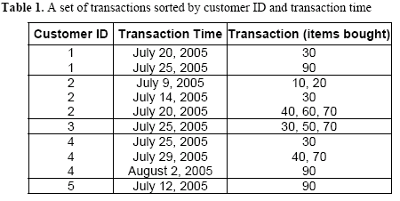
Example

Slide 59
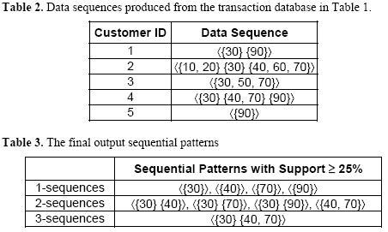
Example (cond)

Slide 60
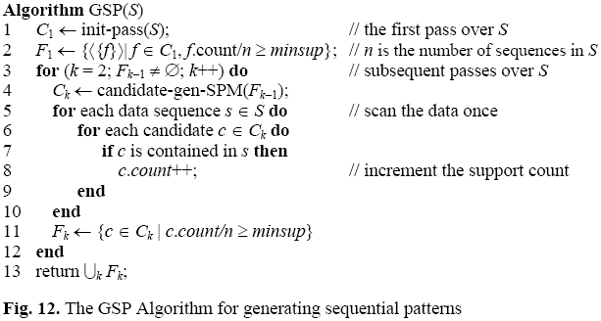
GSP mining algorithm
Very similar to the Apriori algorithm

Slide 61
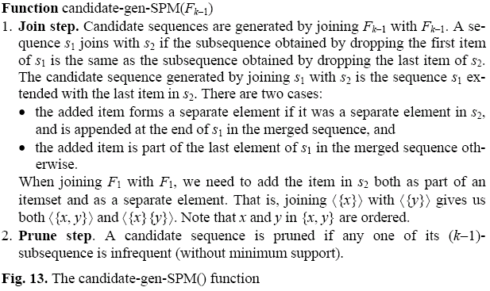
Candidate generation

Slide 62
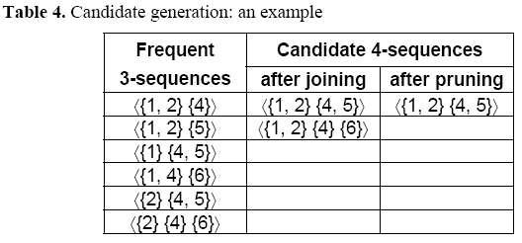
An example

Slide 63
Now it is your turn …
Programming assignment!
Implement two algorithms for sequential pattern mining considering
multiple minimum supports
support difference constraint
Algorithms: (1) MS-GSP, and (2) MSprefixSpan
Each group implements only 1 algorithm
Deadline: Sept 27, 2006 (Demo your program on that day)
Test data sequences will be in one file in the same format as those in the book.

Slide 64
Road map
Basic concepts of Association Rules
Apriori algorithm
Different data formats for mining
Mining with multiple minimum supports
Mining class association rules
Sequential pattern mining
Summary

Slide 65
Summary
Association rule mining has been extensively studied in the data mining community.
So is sequential pattern mining
There are many efficient algorithms and model variations.
Other related work includes
Multi-level or generalized rule mining
Constrained rule mining
Incremental rule mining
Maximal frequent itemset mining
Closed itemset mining
Rule interestingness and visualization
Parallel algorithms
…

